Slide 1
ATLAS Showcase Presentation
Leo Lee
VR Team

Slide 2

About me
Name | Leo Lee
Year / Major | Sophomore / MATH & CS (& Minor in Physics)
Interests | Solving math problems & coding challenges Sports: basketball, cycling, hiking, etc. Music: J-pop, Western, hip hop, soundtracks, etc. Appreciating Internet memes
Fun fact | Without being a huge anime fan, I enjoy listening to J-pop!
Racing Into the Night by YOASOBI,
definitely my favorite song →

Slide 3

“Rage Room” Video Demo
Player moves continuously and turns left or right instantaneously by 45 degrees
A ball spawns on player’s hand when VR controller’s “select trigger” is pressed down and is released when the trigger is released
Ball is thrown out when detached
Objects like block towers or lamp will be destroyed when a ball hits them with speed greater than a certain amount

Slide 4


Internship Goals
Proficiency in…
Unity for VR Game Development
Programming in C# for Unity

Slide 5
Goal 1 – Unity for VR Game Dev
Learning pathway
Easy
Unity UI & essential functions
Unity VR project setup
Medium
Core built-in VR actions
Hard
Ability to integrate the built-in features of the XR Interaction Toolkit into custom scripts

Slide 6
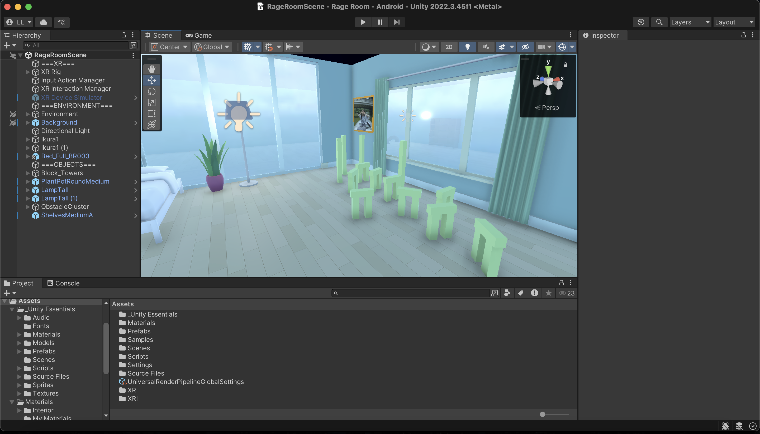
Like an airplane, Unity has a complex control panel, so the very first challenge is to comfortably navigate around Unity.

Slide 7
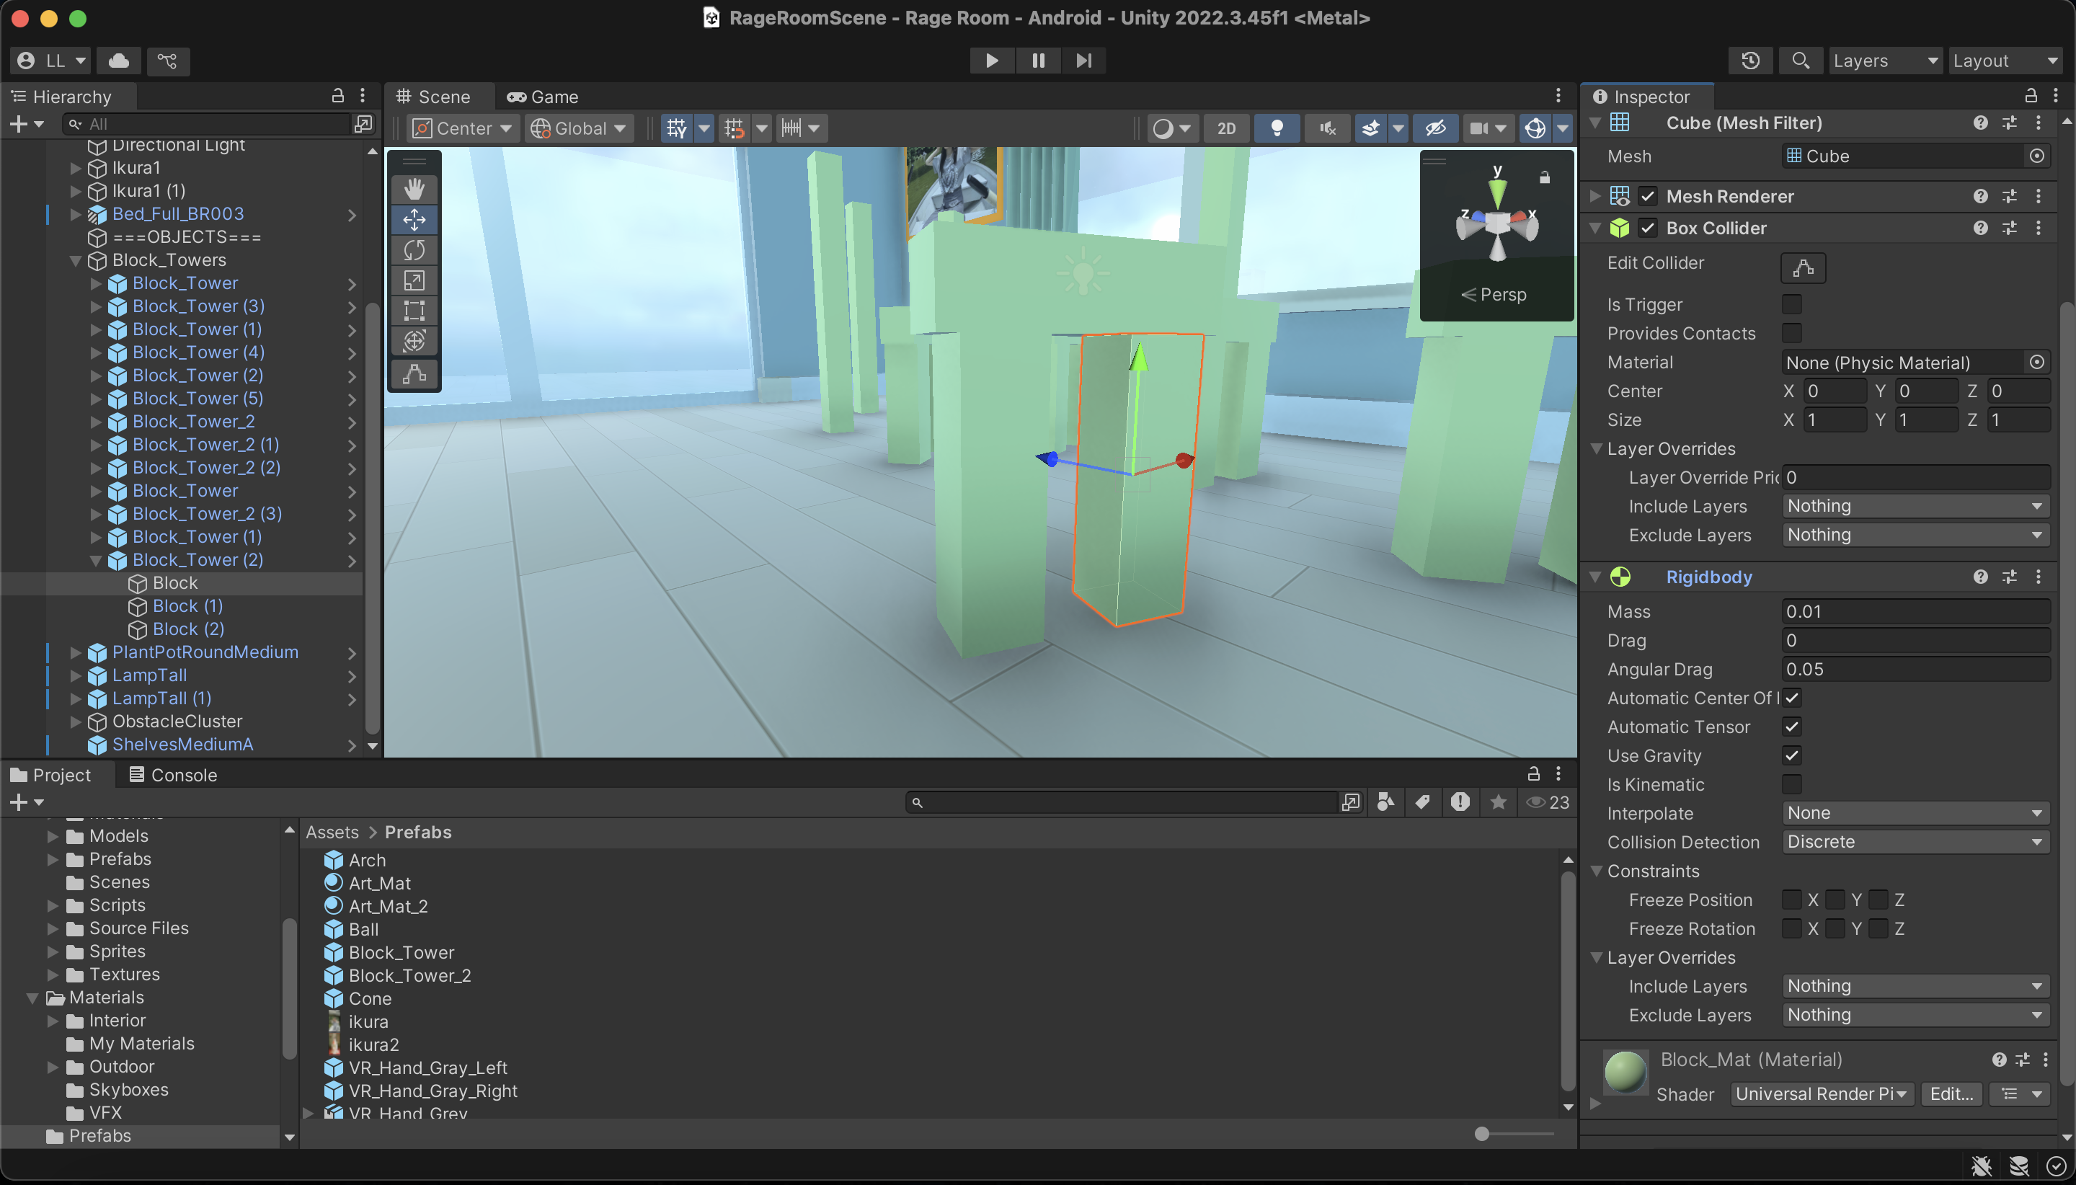
Next, I learn basic functions such as Collider, which enables collision detection, or Rigidbody, which gives object physical properties

Slide 8
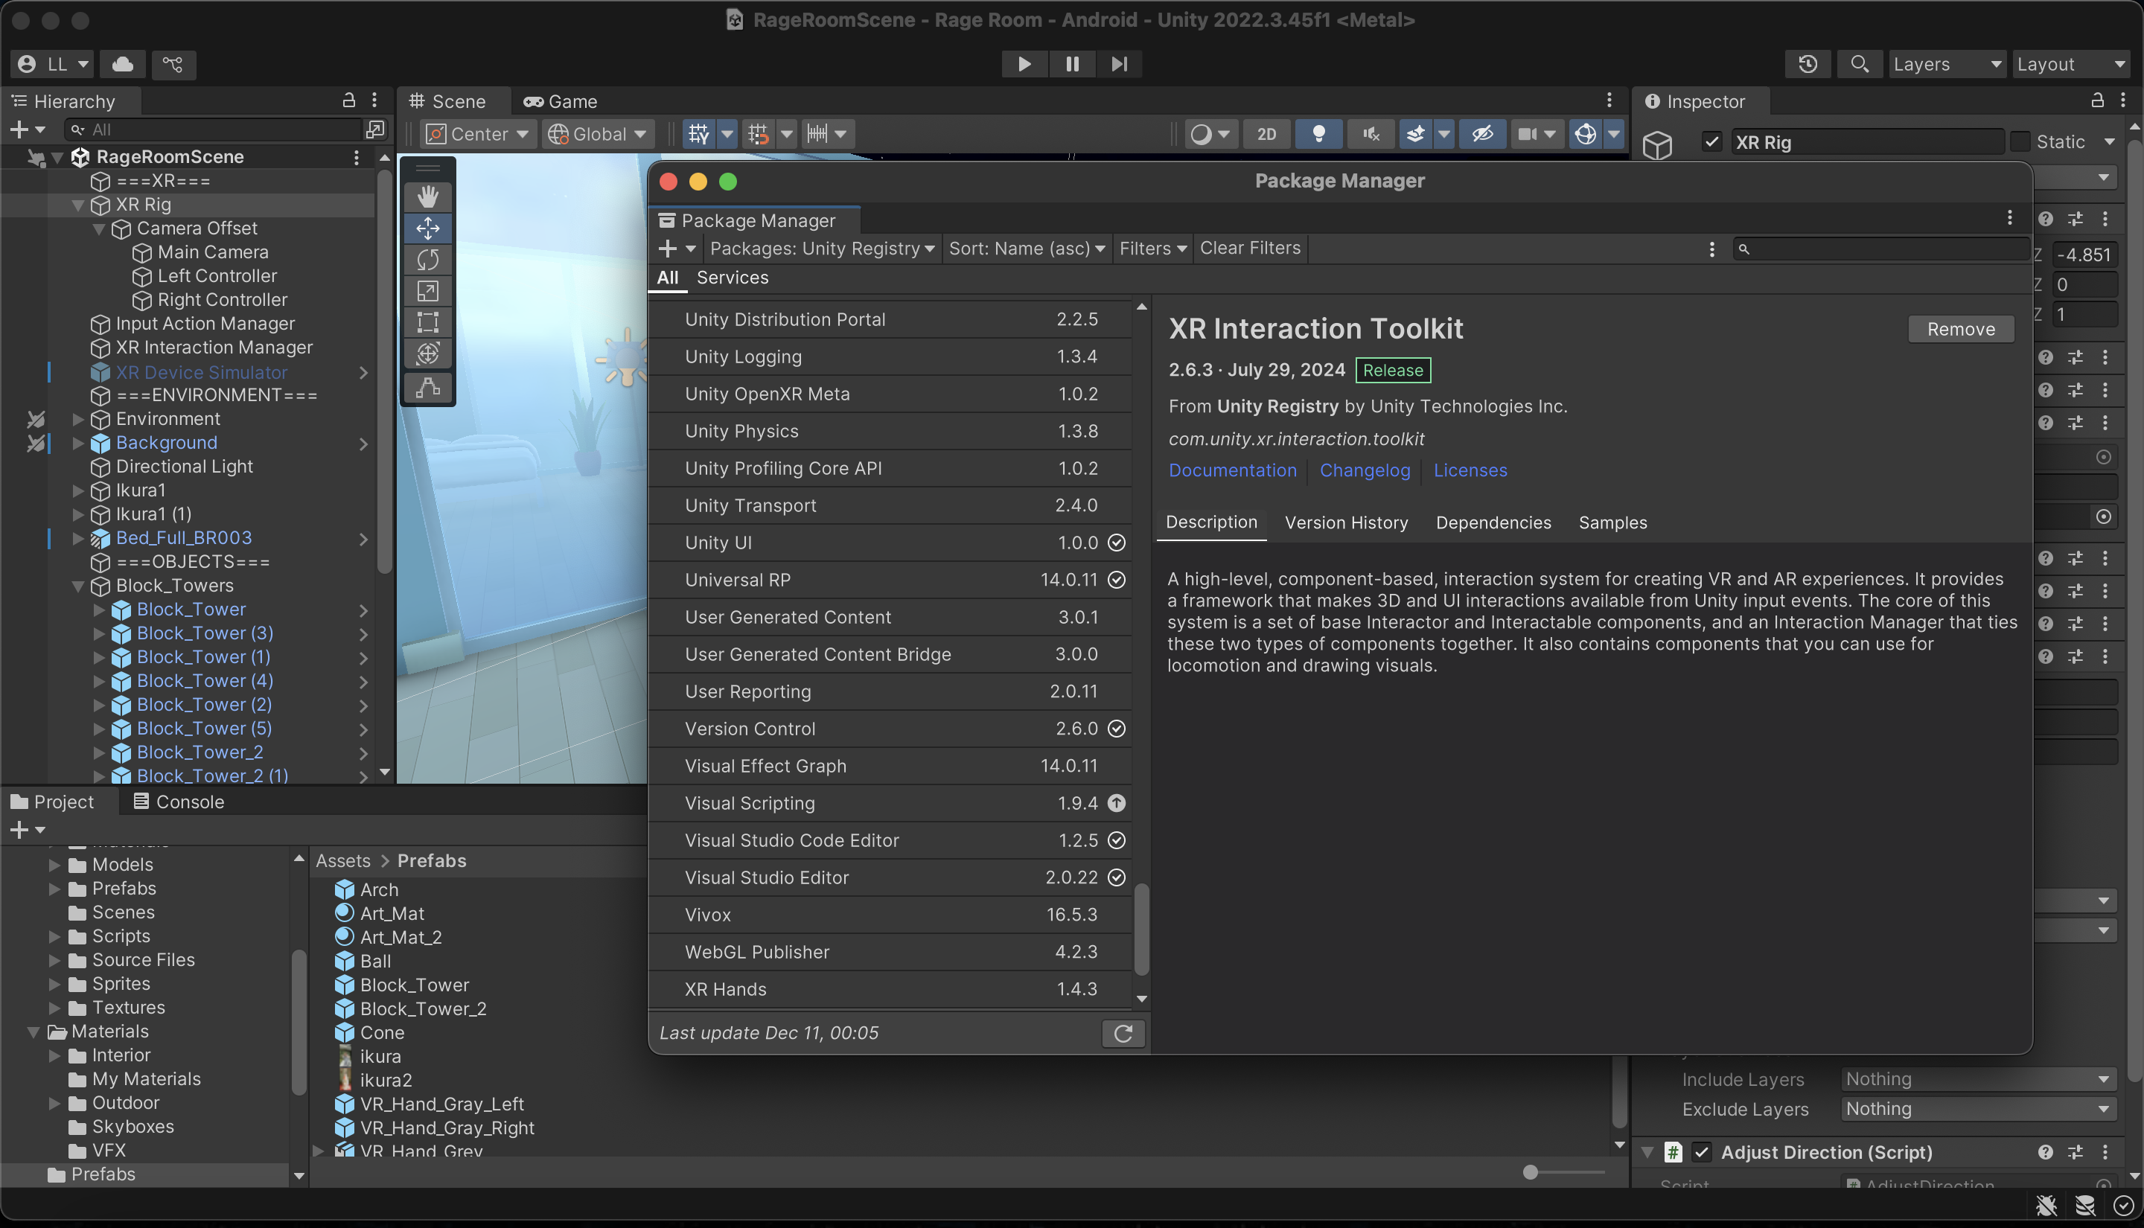
To make the project run on VR device, essential packages needs to be downloaded and a ton of settings needs to be done…

Slide 9
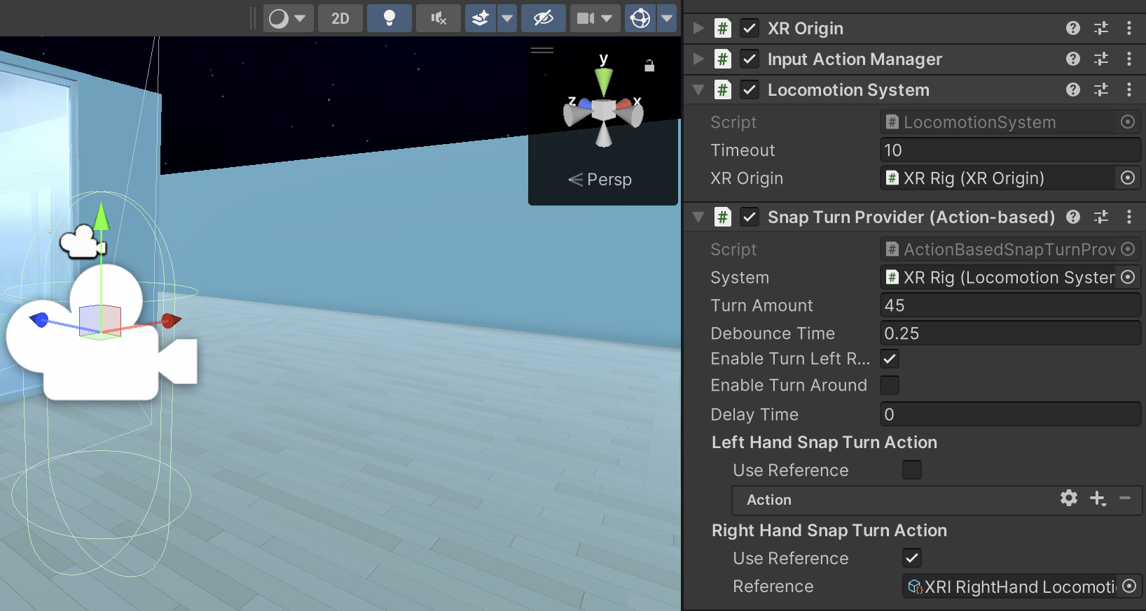
Functions like snap turn or grabbing objects are commonly used in VR apps. Thankfully, they are built-in, so I don’t need to code it myself.

Slide 10
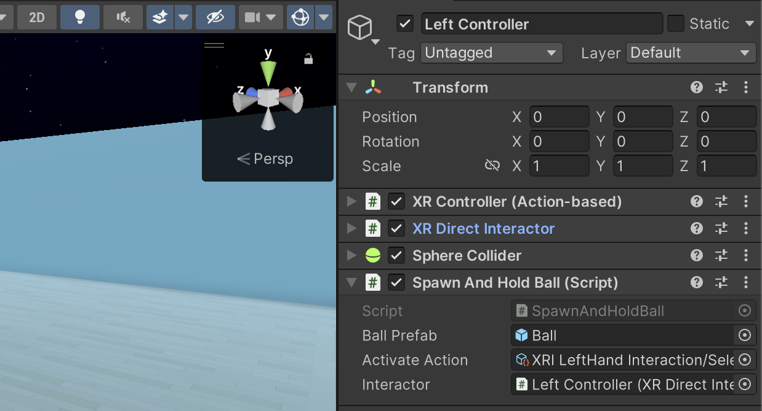
Finally, the hardest part is always customizing it. For example, I built the script “SpawnAndHoldBall” based on the default grabbing action, which only supports grabbing objects that are already existent.

Slide 11
Goal 1 – Unity for VR Game Dev
Challenge: Troubleshooting
Setting up VR project for is not easy: need to consider working systems, VR device, preferred packages etc.
Copying things from the tutorial project to my personal project: e.g., missing material
Solution
Patiently figure out the root cause of the problem instead of immediately find a new method
Do a lot of research
Follow systematic tutorials

Slide 12
Goal 1 – Unity for VR Game Dev
Learning resources
Hello World | Meta Horizon OS Developers
Unity Learn: Unity Essentials & VR Development pathways
Quality YouTube channels like Valem
Unity Documentation

Slide 13
Goal 2 – Programming in C# for Unity
Learning pathway
Easy
basic structure of a C# script
Medium
common functions of Unity
Hard
integration with external libraries like XR Interaction Toolkit

Slide 14
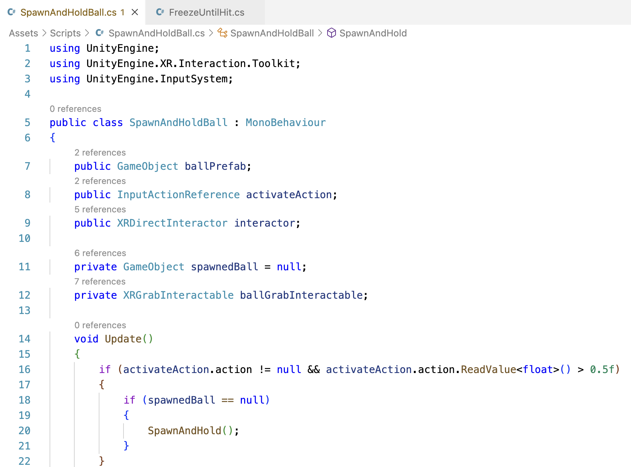
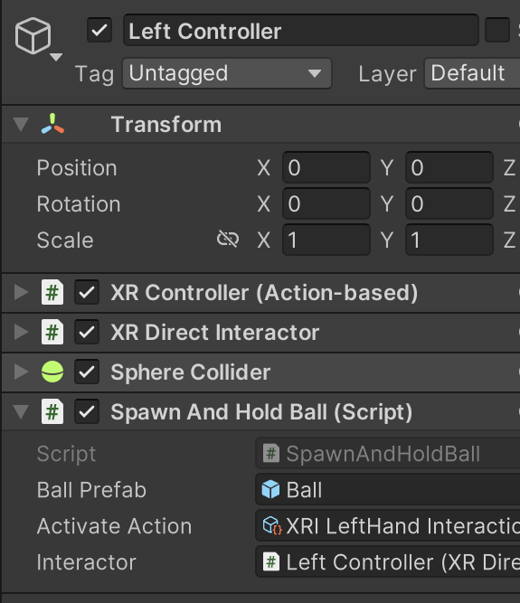
Like grammar, a script has a structure. For example, public data members often represents foreign objects or scripts that are assigned in UI

Slide 15
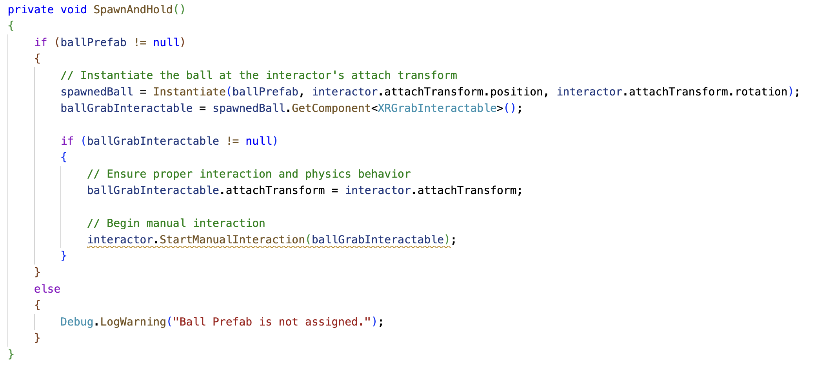
Built-in functions like Instantiate or classes like Transform are very commonly used. Just like vocabulary, the only way to get used to them is to use them again and again.

Slide 16
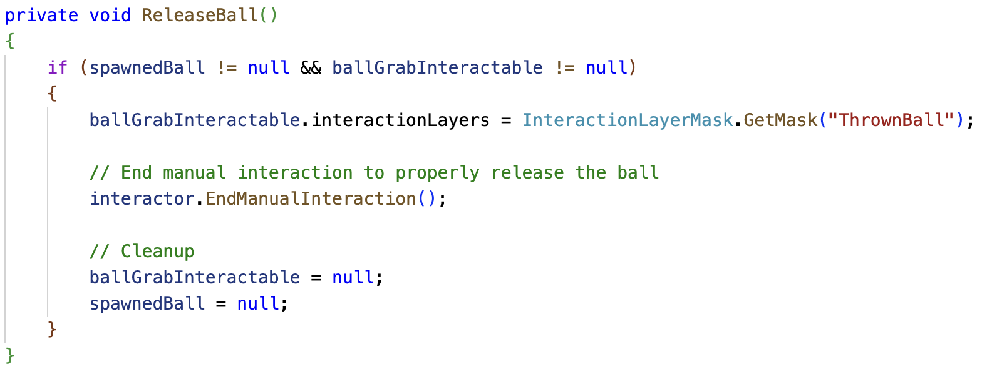
Following basic Unity functions are functions from XR Interaction Toolkit—just more features to learn.

Slide 17
Goal 2 – Programming in C# for Unity
Challenge: How to Find the Function for This and That
Most functions or classes are pre-written, and the logic is usually not hard, which means my prior coding experience does not help much
No other way but to search functions one by one in the documentation, which is inefficient and boring
Solution
Since AI has an enormous database, let it to the dull job
Follow systematic tutorials to know how to communicate with AI
Do a lot of research just to make small fixes—frustrating but unavoidable
Learning resources
Unity Learn: Junior Programming pathway
Unity Documentation

Slide 18
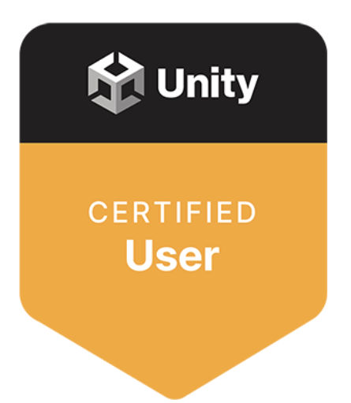
Future Goals
Continue my unfinished pathways and get certifications
Develop another Unity 3D game independently

Slide 19
Special thanks to…
ATLAS team for accepting me into the internship program and providing VR device
Michael, Randy, and Anju for leading the team meetings, giving game ideas, and providing support

Slide 20


